Slide 1

PASS Program/Testing Center
Placement Advising for Student Success
Notes:
Updated 11-17-16

Slide 2
PASS/Testing Center Updates
Overview of PASS and Student Placement Process
Placement Advising Coordinator Position
PASS Faculty Updates
PASS Programs Intersections with other Teams and Programs
Data Analysis
Contact Information
Testing Center Updates
Accuplacer Next Generation (new placement tests)
Remodel Update

Slide 5
  Math Placements (self-report and/or unofficial transcripts)
Graduated or passed GED within 2 years GPA Scores: GED 2014, SAT, ACT Math coursework and grades Full time vs. part time student Less than 20 hours of weekly commitments Feelings about math (positive or negative) | Graduated or passed GED more than 2 years ago GPA Scores: GED, SAT, ACT Past math courses and math experience Full time vs. part time student Less than 20 hours of weekly commitments Has degree beyond HS diploma Job requires math skills Feelings about math (positive or negative)
2. Consider Educational Goals – Math Pathways Career Tech Path STEM Path Alternate Path MTH 020, MTH 050, MTH 080 MTH 020, MTH 060, MTH 065, MTH095, MTH 111, MTH 112, MTH 251 MTH 020, MTH 098, MTH 105, MTH 243
3. Use Math Faculty: specific questions about math skills correlating to math placement
4. Placement Test Accuplacer (currently) or New Generation Accuplacer (near future) Program requirements: apprenticeships, admissions to various programs
Challenges: Scaling-up to all incoming students- creating tools for advisors Covering multiple entry points (online enrollment, advising, testing center, high schools, three campuses) Systematizing student support crosswalks (tutoring, math lab)

Slide 6
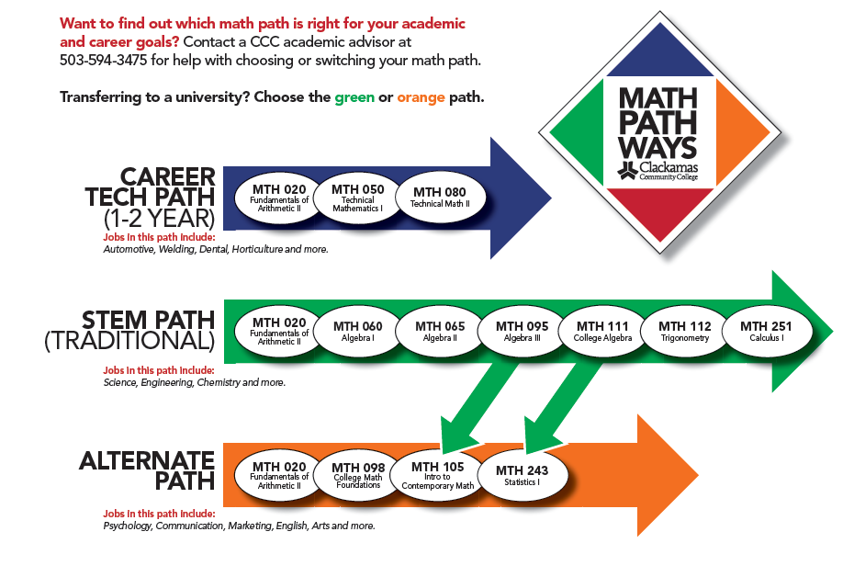

Slide 7
  Writing Placements (self-report and/or unofficial transcripts)
1. Graduated or passed GED within 5 years GPA Scores: GED, SAT, ACT English coursework and grades Has written 3 page essays or research papers? Interest in reading Full time vs. part time student Less than 20 hours of weekly commitments Feelings about writing (positive or negative) Writing sample Motivation level | Graduated or passed GED more than 5 years ago GPA Scores: GED, SAT, ACT Past English courses and writing experience Has written 3 page essays or research papers? Interest in reading Full time vs. part time student Less than 20 hours of weekly commitments Has degree beyond HS diploma Job requires writing and reading skills Feelings about writing (positive or negative) Writing sample Motivation level
2. Consider Educational Goals: Career Tech Path University Transfer
3. Use Writing Faculty: specific questions about writing skills correlating to writing placement
4. Placement Test Accuplacer (currently) or New Generation Accuplacer (near future) Program requirements: apprenticeships, admissions to various programs
Challenges: Scaling-up to all incoming students- creating tools for advisors Covering multiple entry points (online enrollment, advising, testing center, high schools, three campuses) Systematizing student support crosswalks (tutoring, writing center)

Slide 8
Next Steps
Continue to scale up with refinement of placement tools and training of advising and support staff, including Welcome Center’s partnership with high schools
Continue to improve placement process with success data and faculty input
Develop support referral process to accompany placement recommendations

